Slide 1


SonarQube

Slide 2


Slide 3
Installation
Go to: https://www.sonarqube.org/donwloads

Slide 4
Installation
Extract the files of
the download in a folder , then enter to the console with cmd in
and go to the folder where
SonarQube is unzipped.

Slide 5
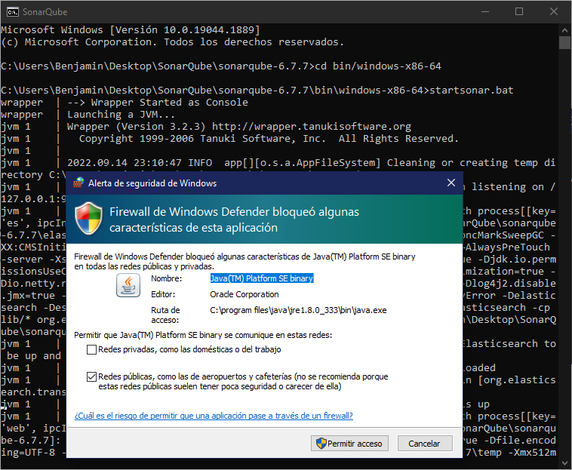
SonarQube
Run StartSonar.bat in the cmd and then allow access so it can be executed.

Slide 6
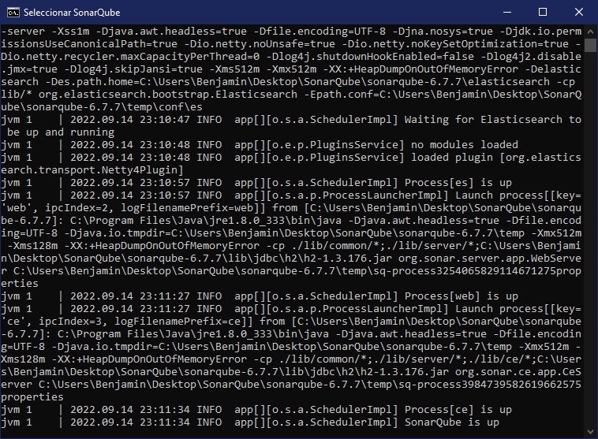
SonarQube
Verify that the process is active

Slide 7
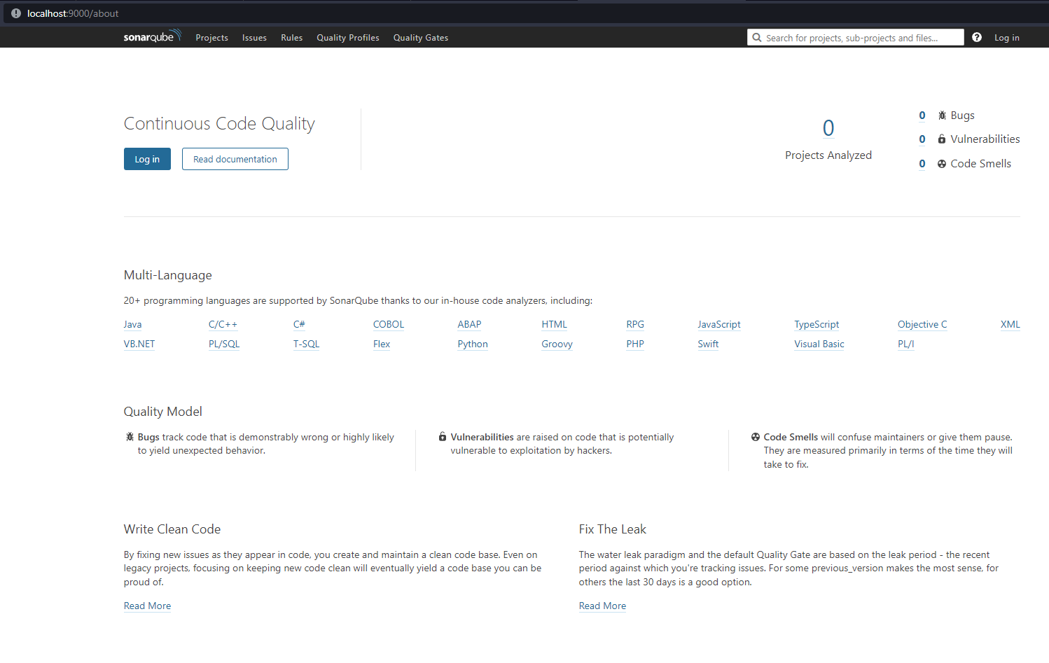
SonarQube
Enter to localhost:9000

Slide 8
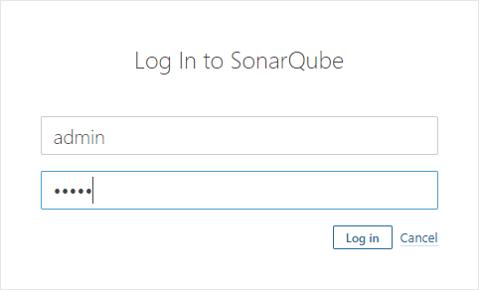
SonarQube
Go to Log In
and enter admin for user and admin for password

Slide 9
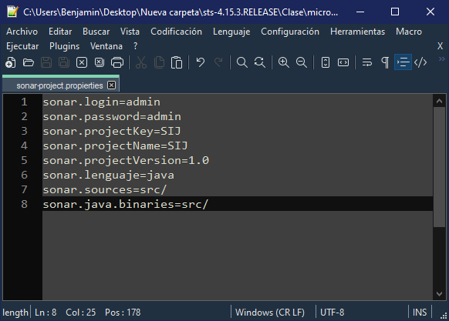
SonarQube
In a Java project, create sonar-project.properties
Enter the data shown and then save.
In this case we’re using our Microservices project as example

Slide 10
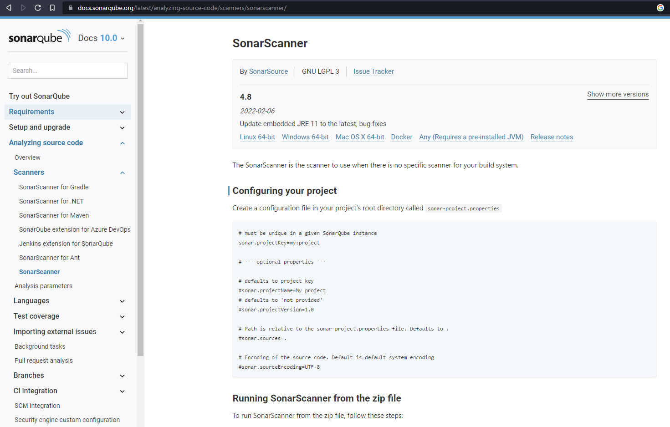
SonarQube
Download sonar-scanner:
https://docs.sonarqube.org/latest/analyzing-source-code/scanners/sonarscanner/

Slide 11
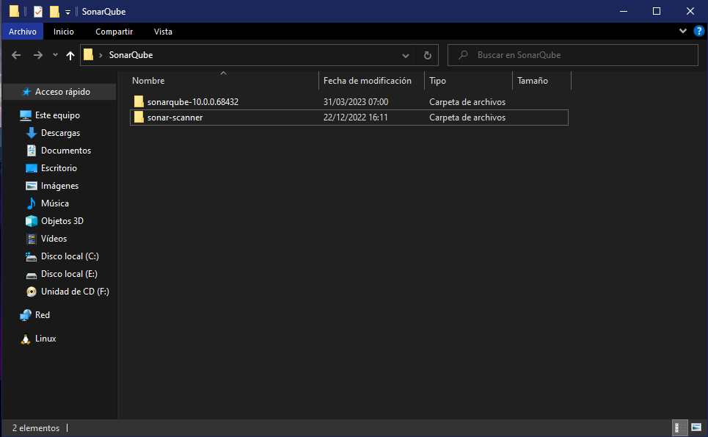
SonarQube
Unzip sonar-scanner

Slide 12
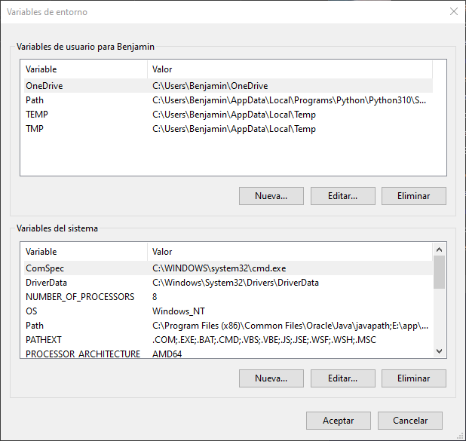
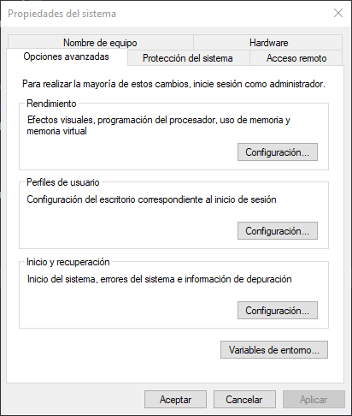
SonarQube
Go to environment variables

Slide 13
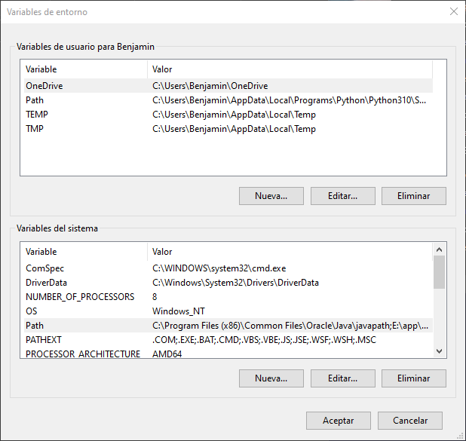
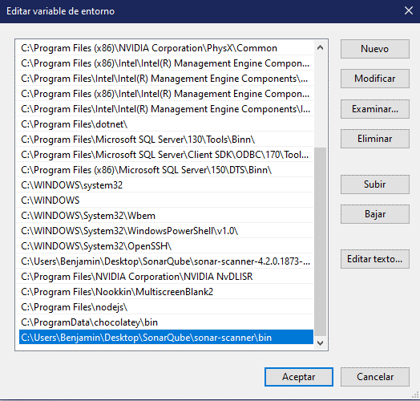
SonarQube
Then, in the Path, enter the bin path of sonar-scanner

Slide 14
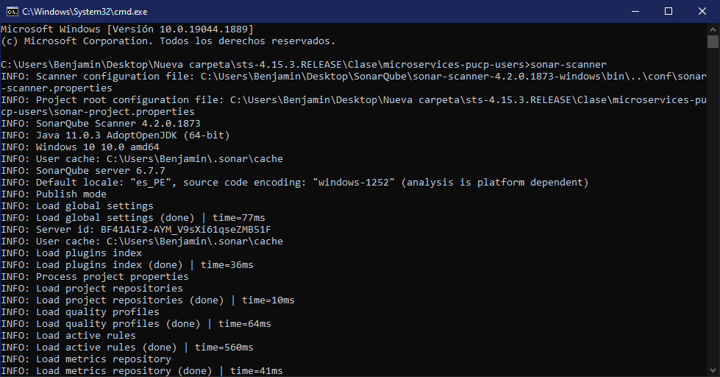
SonarQube
Go to the project folder and run sonar-scanner

Slide 15
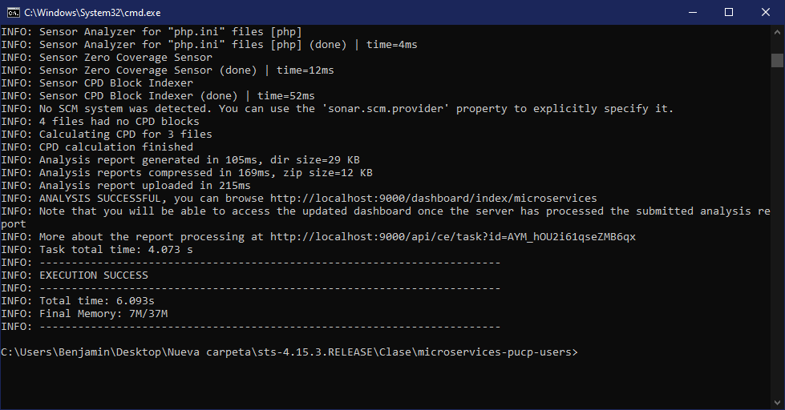
SonarQube
If it shows that the execution was successful. Go to the web console.

Slide 16
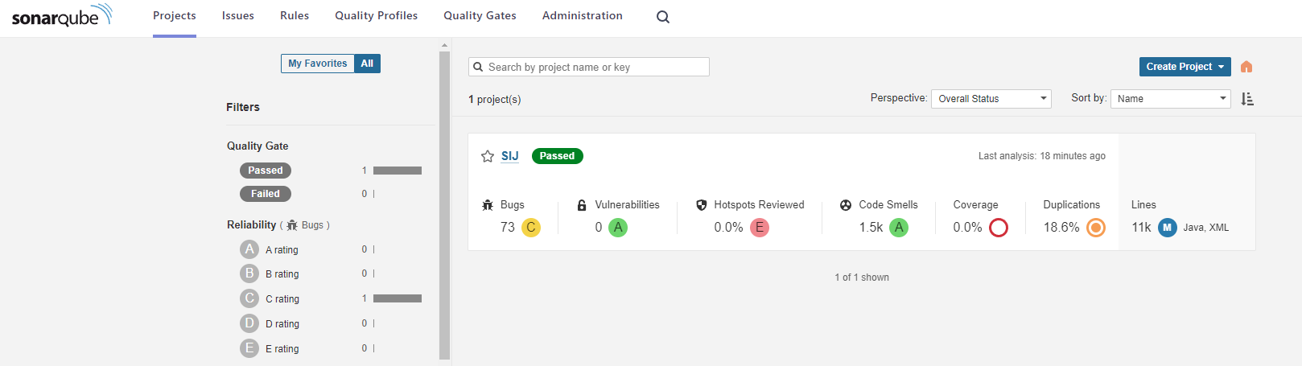
SonarQube
Project added to Sonarqube

Slide 17

Discussion:
What is a Code Smells?

Slide 18

Code Smells
The code smells itself is not a defect but a potential problem

Slide 19

Code Smells
When detecting something in the code that does not smell good, it is like seeing an alarm light that turns on in our code and that is a signal to act, being the ideal moment to improve our code.

Slide 20

Code Smells
How to identify a Code Smells?

Slide 21

Code Smells
Comments
Longer methods
Very large classes
Very long parameter list
Meaningless names
Names not existent
Dead code

Slide 22
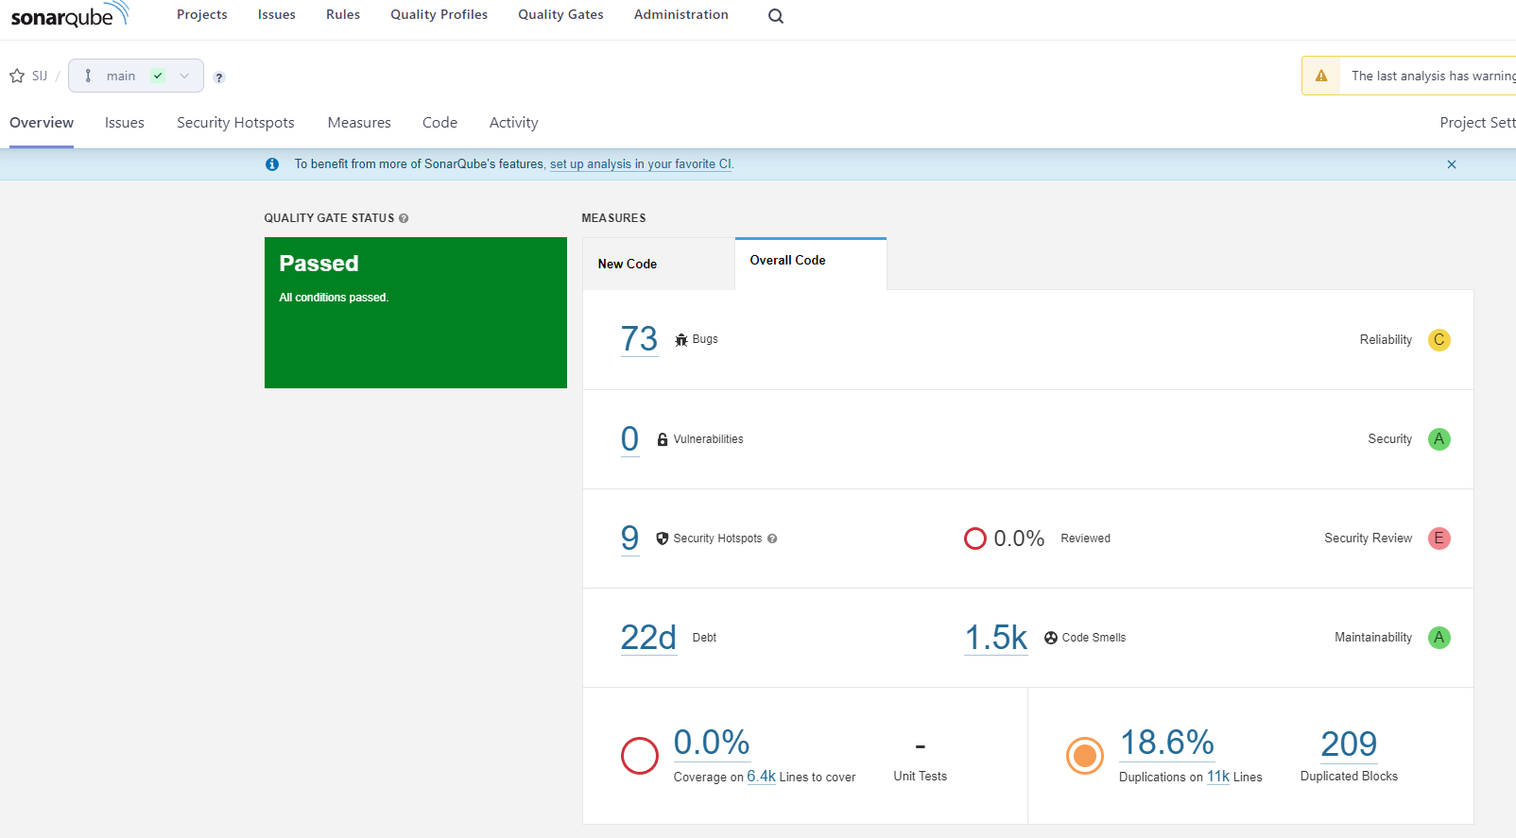
Code Smells

Slide 23
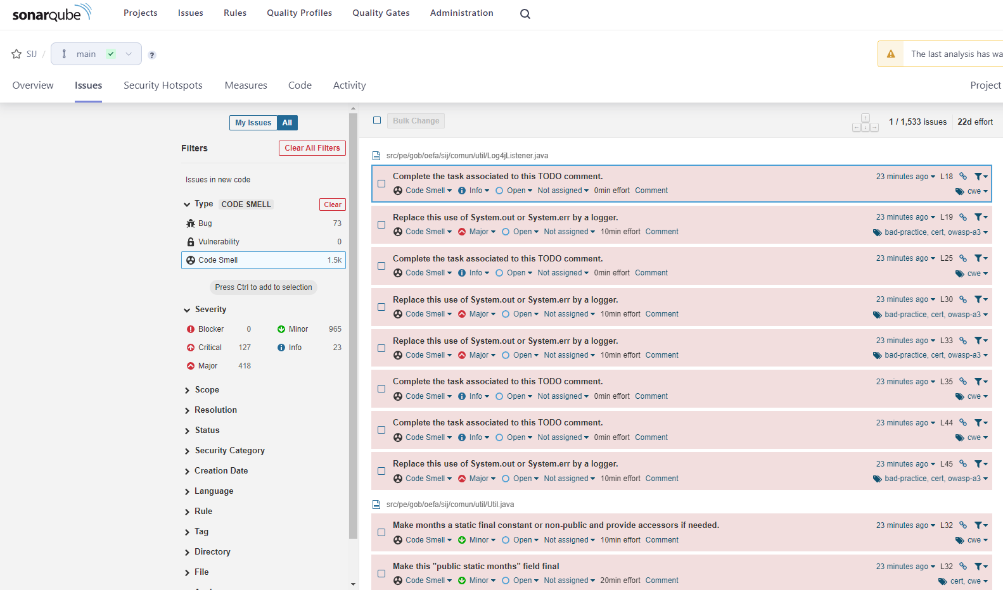
Code Smells

Slide 24
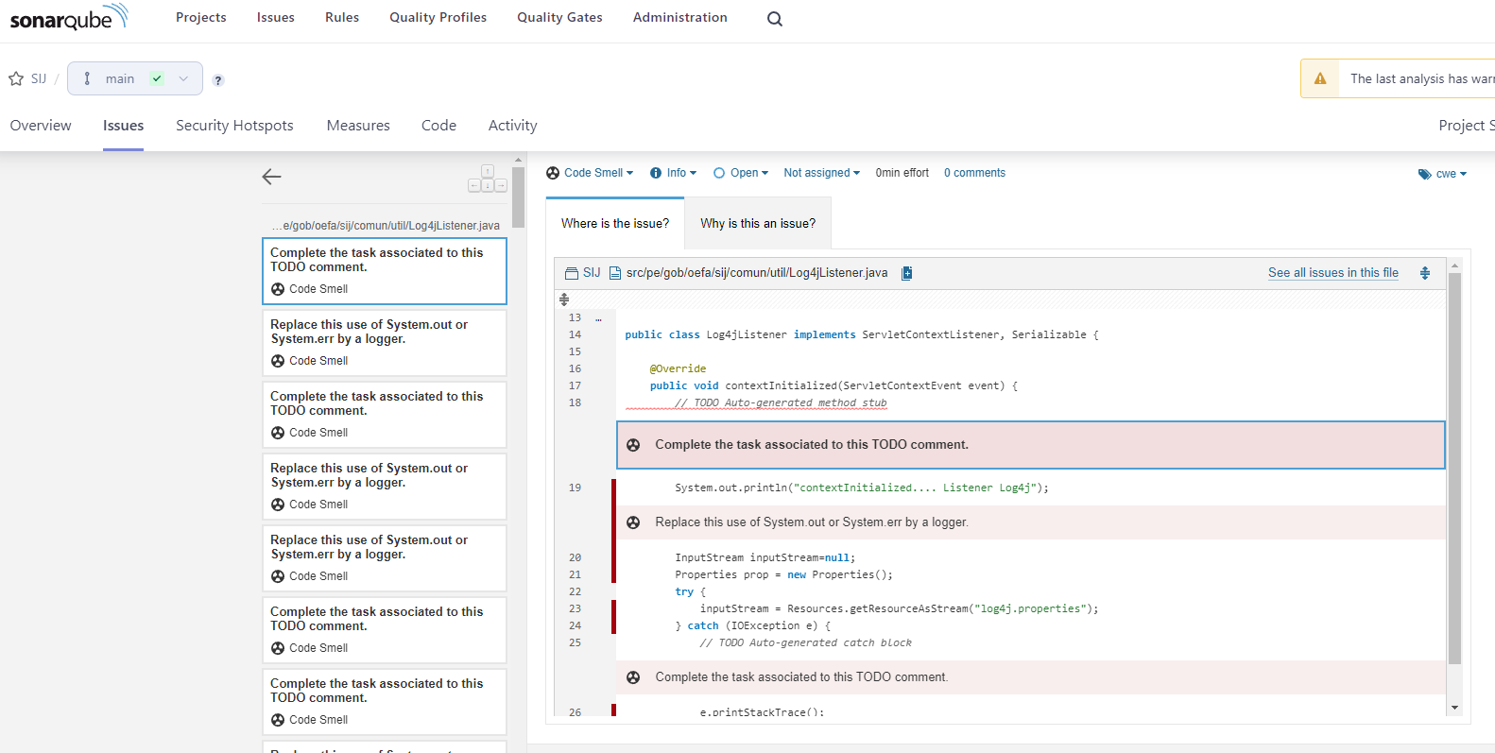
Code Smells

